Slide 1
Analysis of Gun Shootings in USA 2007 to 2016
Sunitha ‘s portion - Data Bootcamp |
2018

Slide 2
Story
With the recent mass shootings that have been happening all across the country, especially in schools and the most recent one on Feb 14th at Parkland School in FL, I was really touched and wanted to find the epidemic created by these senseless mass shootings
That prompted me to choose this topic for analysis
I have watched 60 minutes on CBS show and the march that took place on March 24th across the nation
Question:
I wanted to understand the magnitude of shootings and the resulting deaths by county
Following charts will demonstrate the results of this analysis

Slide 3


Slide 4
Challenges of collecting geolocate (latitude & longitude) to given an county address
Could not get for free, the latitude and longitude coordinates with https://carto.com/location-data-services/geocoding/ given a city name.
Used Google Maps API to geolocate a query to an address and coordinates: https://developers.google.com/maps/
Also tried with geopy which is a Python 2 and 3 client for several popular geocoding web services. https://pypi.python.org/pypi/geopy#downloads

Slide 5
Challenges of collecting Population to Every County in a State
United States Census Bureau https://www.census.gov/quickfacts/fact/table/US/PST045217
https://en.wikipedia.org/wiki/List_of_counties_in_California
https://www.census.gov/data/datasets/2016/demo/popest/counties-detail.html
https://factfinder.census.gov/faces/tableservices/jsf/pages/productview.xhtml?src=bkmk
US Census API– don’t have all the data only with some of the years, county & state FIPS
https://api.census.gov/data/2010/sf1?key=6756f7325cf88843d478018eb4f3e62e87d767c4&get=P0010001&in=state:006&for=county:001
https://stackoverflow.com/questions/28933220/us-census-api-get-the-population-of-every-city-in-a-state-using-python

Slide 6
Visualization of Gun Shootings and Death Toll in the United States of America!
Notes:
It’s important to keep in mind why you joined this class. Let’s talk about your goals.

Slide 7
Number of Deaths by County in the USA without normalization
Cluster Circle Markers Visualization – Represents the number of deaths in each county
Size of the radius represents the total number of deaths for that County
// Define a markerSize function that will give each county a different radius based on its deaths function markerSize(deaths) {return deaths * 1000;} <= This will make the marker’s size proportionate to its death counts
radius: markerSize(deaths) <= This determines the Radius of the Circle
Interactive map of the US with numbers of deaths , setting the circles radius equal to the output of the markerSize function.

Slide 8
Actual Deaths Data Table
Deaths <100
County Name, State | # of Deaths
Contra Costa County, CA | 96
Sacramento County, CA | 95
Hamilton County, OH | 87
Oklahoma County, OK | 66
San Joaquin County, CA | 66
San Diego County, CA | 63
Fresno County, CA | 48
Kern County, CA | 41
Erie County, NY | 37
Mecklenburg County, NC | 36
Davidson County, TN | 34
Genesee County, MI | 33
Fairfield County, CT | 28
Hillsborough County, FL | 24
Suffolk County, MA | 24
King County, WA | 23
Orange County, CA | 23
Pima County, AZ | 22
Montgomery County, OH | 21
Tulsa County, OK | 20
San Francisco County, CA | 14
Baltimore County, MD | 12
Mobile County, AL | 12
Pulaski County, AR | 12
Broome County, NY | 11
Camden County, NJ | 11
Douglas County, NE | 11
El Paso County, CO | 11
Osceola County, FL | 11
Summit County, OH | 11
Allen County, IN | 10
Bernalillo County, NM | 10
Monterey County, CA | 10
Montgomery County, VA | 10
New Castle County, DE | 10
Queens County, NY | 10
Wyandotte County, KS | 10
Deaths >100 & <1000
County Name, State | # of Deaths
Kings County, NY | 898
Marion County, IN | 663
Alameda County, CA | 591
St. Louis city, MO | 506
Fulton County, GA | 486
Duval County, FL | 476
Essex County, NJ | 459
Clark County, NV | 444
Bexar County, TX | 435
San Bernardino County, CA | 429
Cuyahoga County, OH | 428
Jackson County, MO | 427
Jefferson County, AL | 414
District of Columbia, DC | 396
Milwaukee County, WI | 379
Franklin County, OH | 277
Allegheny County, PA | 273
Prince George's County, MD | 268
St. Louis County, MO | 247
Tarrant County, TX | 184
DeKalb County, GA | 183
Bronx County, NY | 180
Riverside County, CA | 177
East Baton Rouge Parish, LA | 173
Orange County, FL | 160
Palm Beach County, FL | 151
Broward County, FL | 139
Lake County, IN | 113
Jefferson County, KY | 110
Jefferson Parish, LA | 101
Deaths >1000
County Name, State | # of Deaths
Los Angeles County, CA | 5252
Cook County, IL | 5113
Wayne County, MI | 3044
Harris County, TX | 2984
Philadelphia County, PA | 2588
Maricopa County, AZ | 1851
Miami-Dade County, FL | 1845
Baltimore city, MD | 1743
Dallas County, TX | 1389
Orleans Parish, LA | 1241
Shelby County, TN | 1117

Slide 9
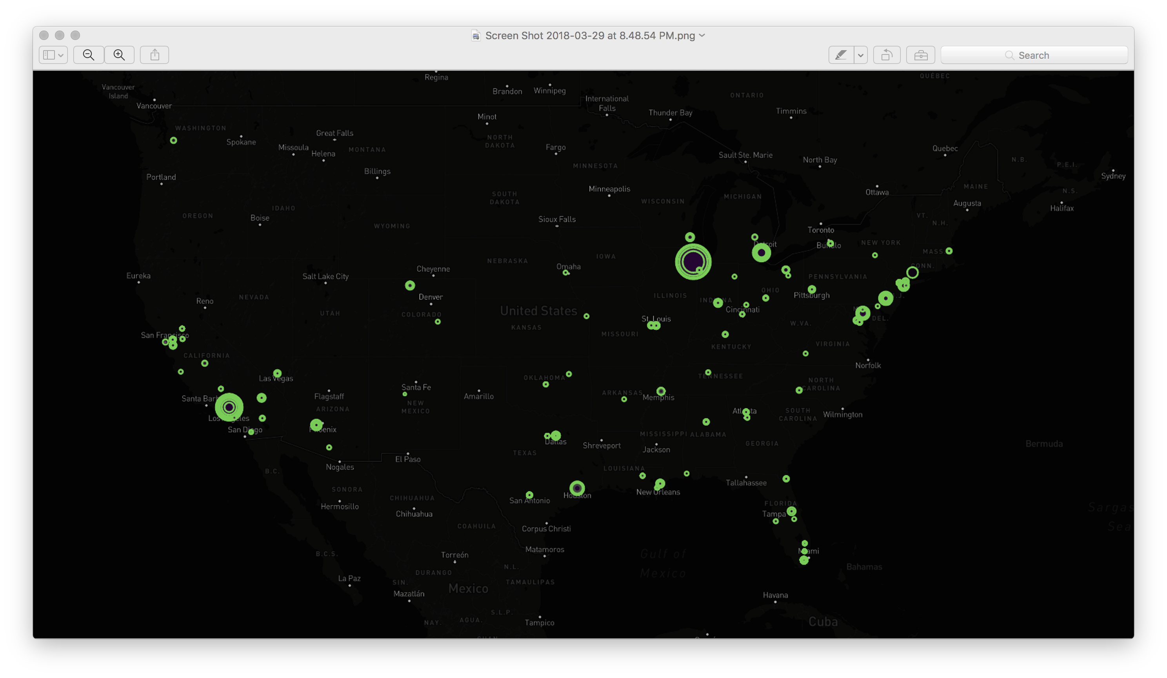
Map of Death toll by County in USA without normalization

Slide 10
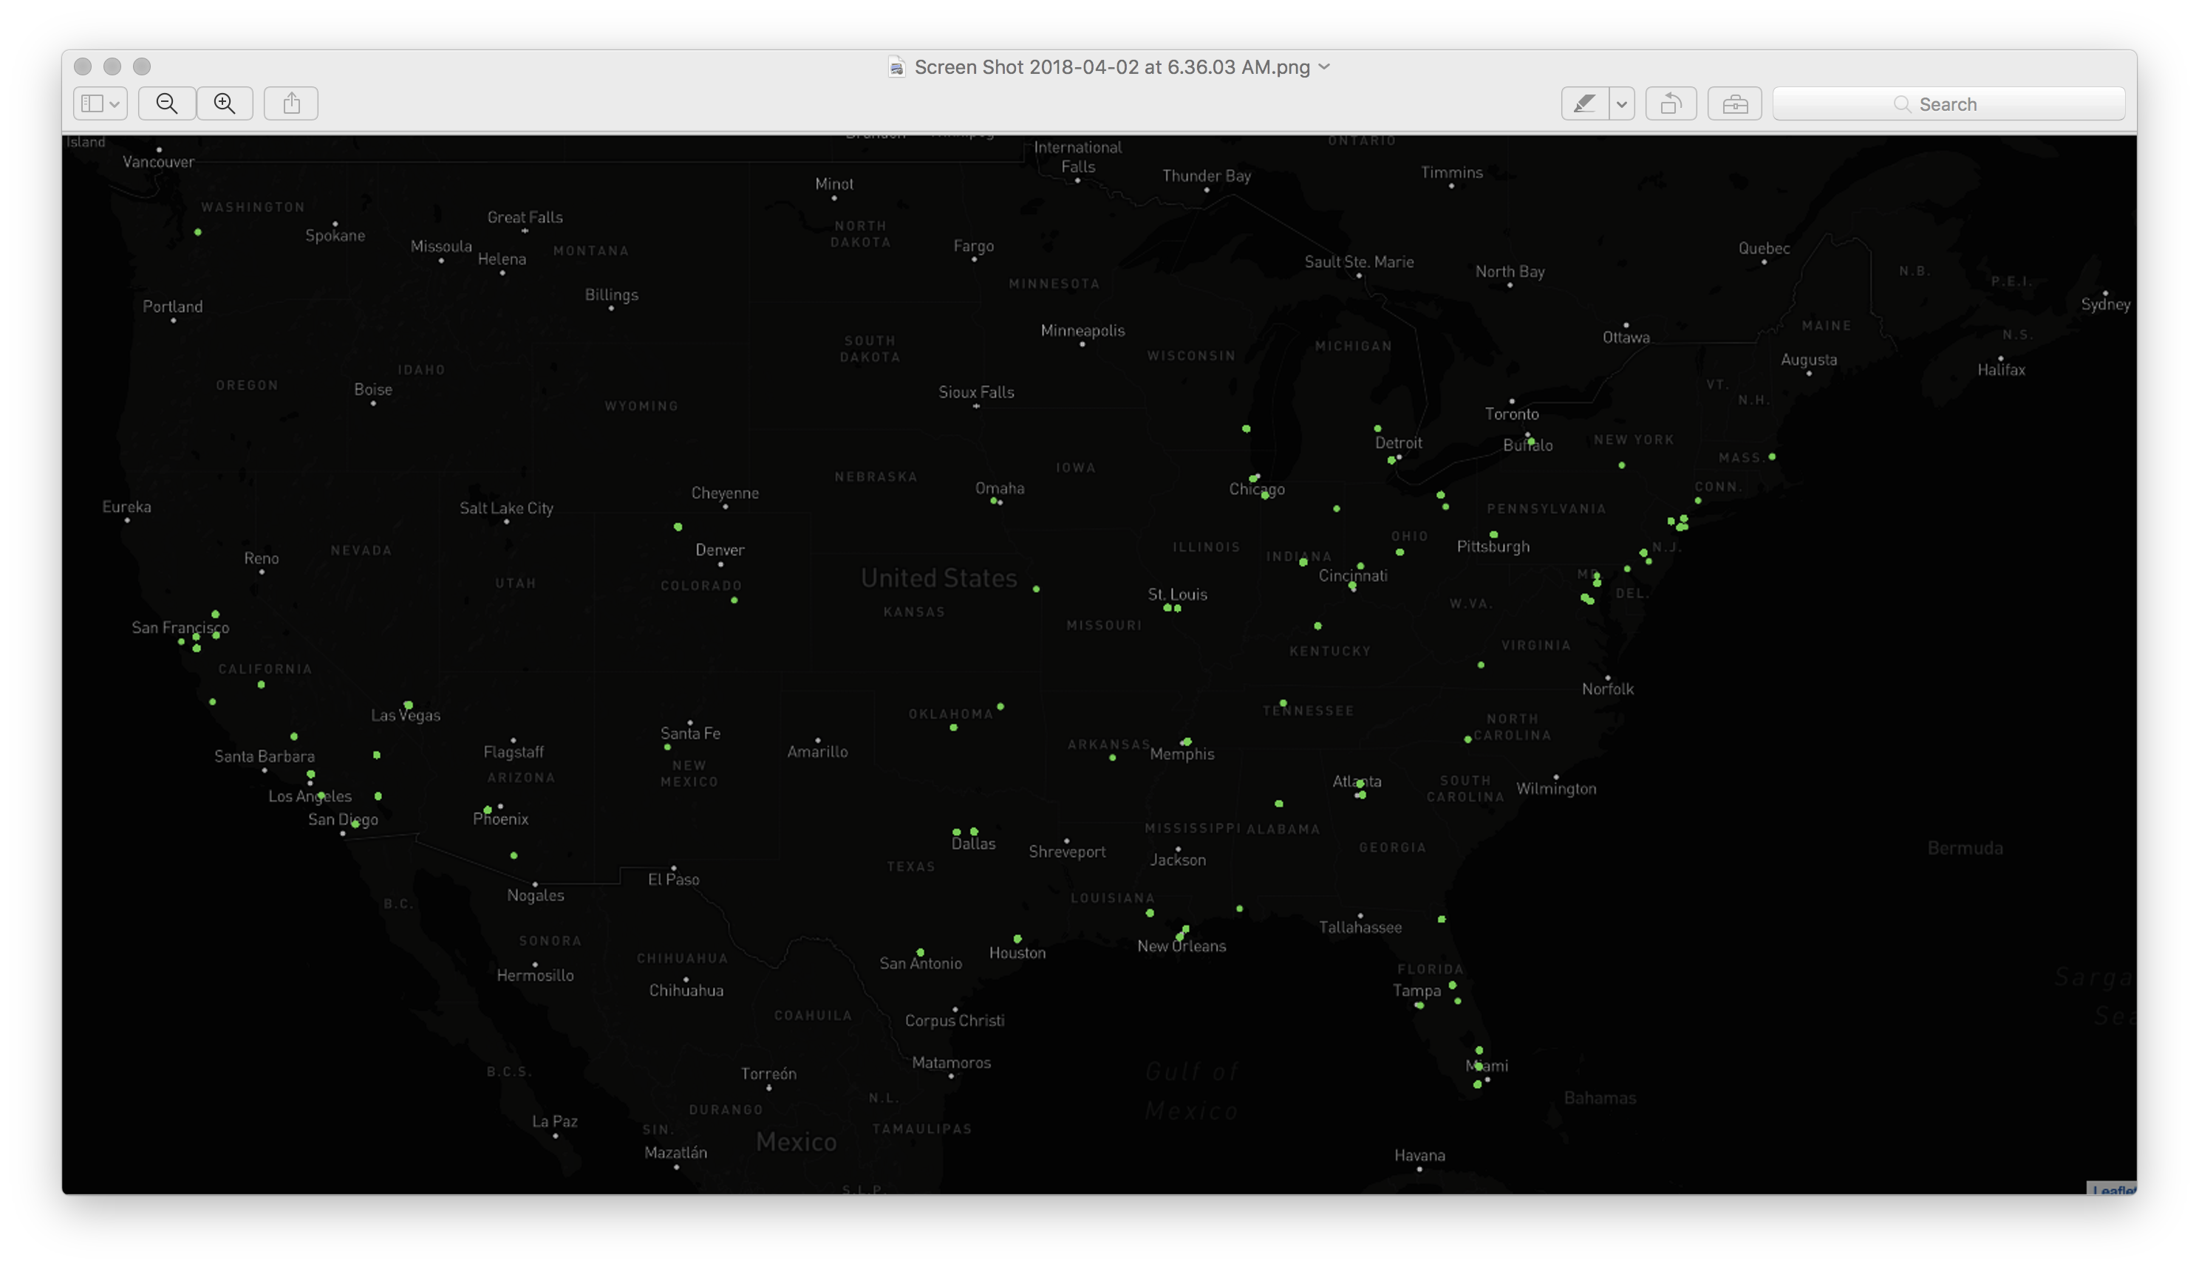
Normalized death data – by county per 100,000 population

Slide 11
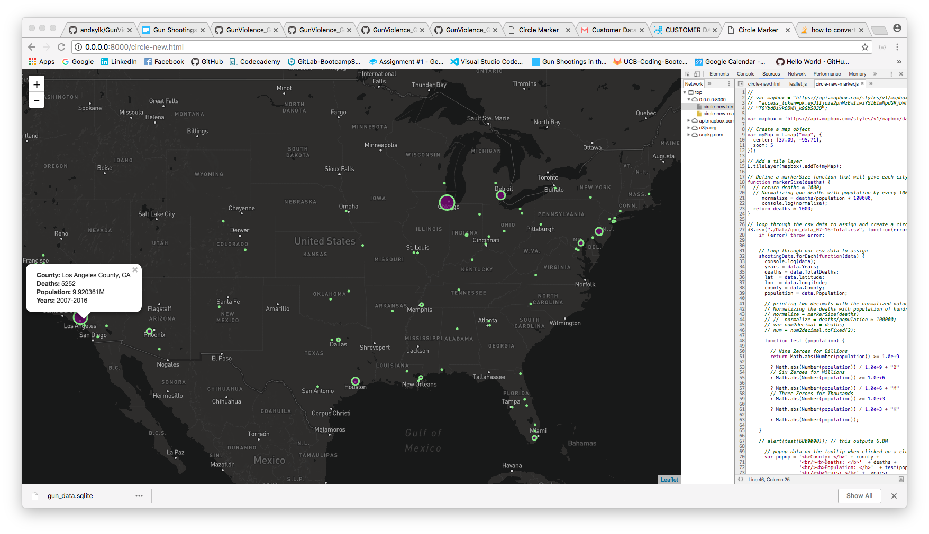
Counties with the highest number of deaths cause by gun violence

Slide 12
Count of Mass shootings by County in USA
Cluster Markers Visualization – Represents the number of Mass shootings in a given county
Interactive map of the US – Provides
Month/Year of the shootings
Number of Deaths
County Names
User can zoom in for granular info for time based data for a given county

Slide 13
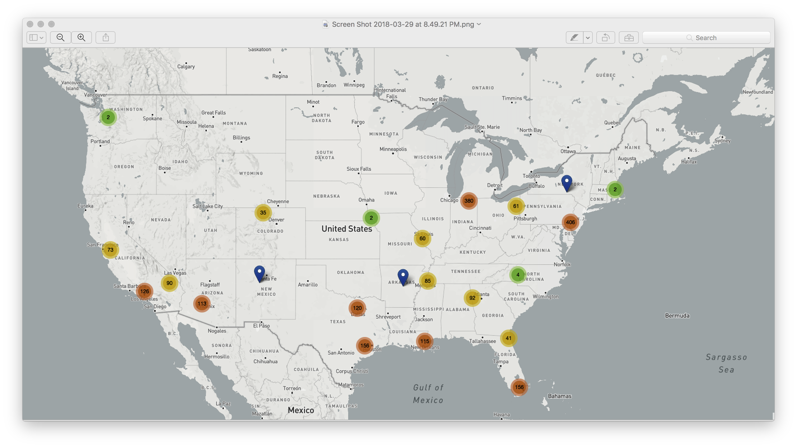
Count of Mass shootings by County in USA

Slide 14
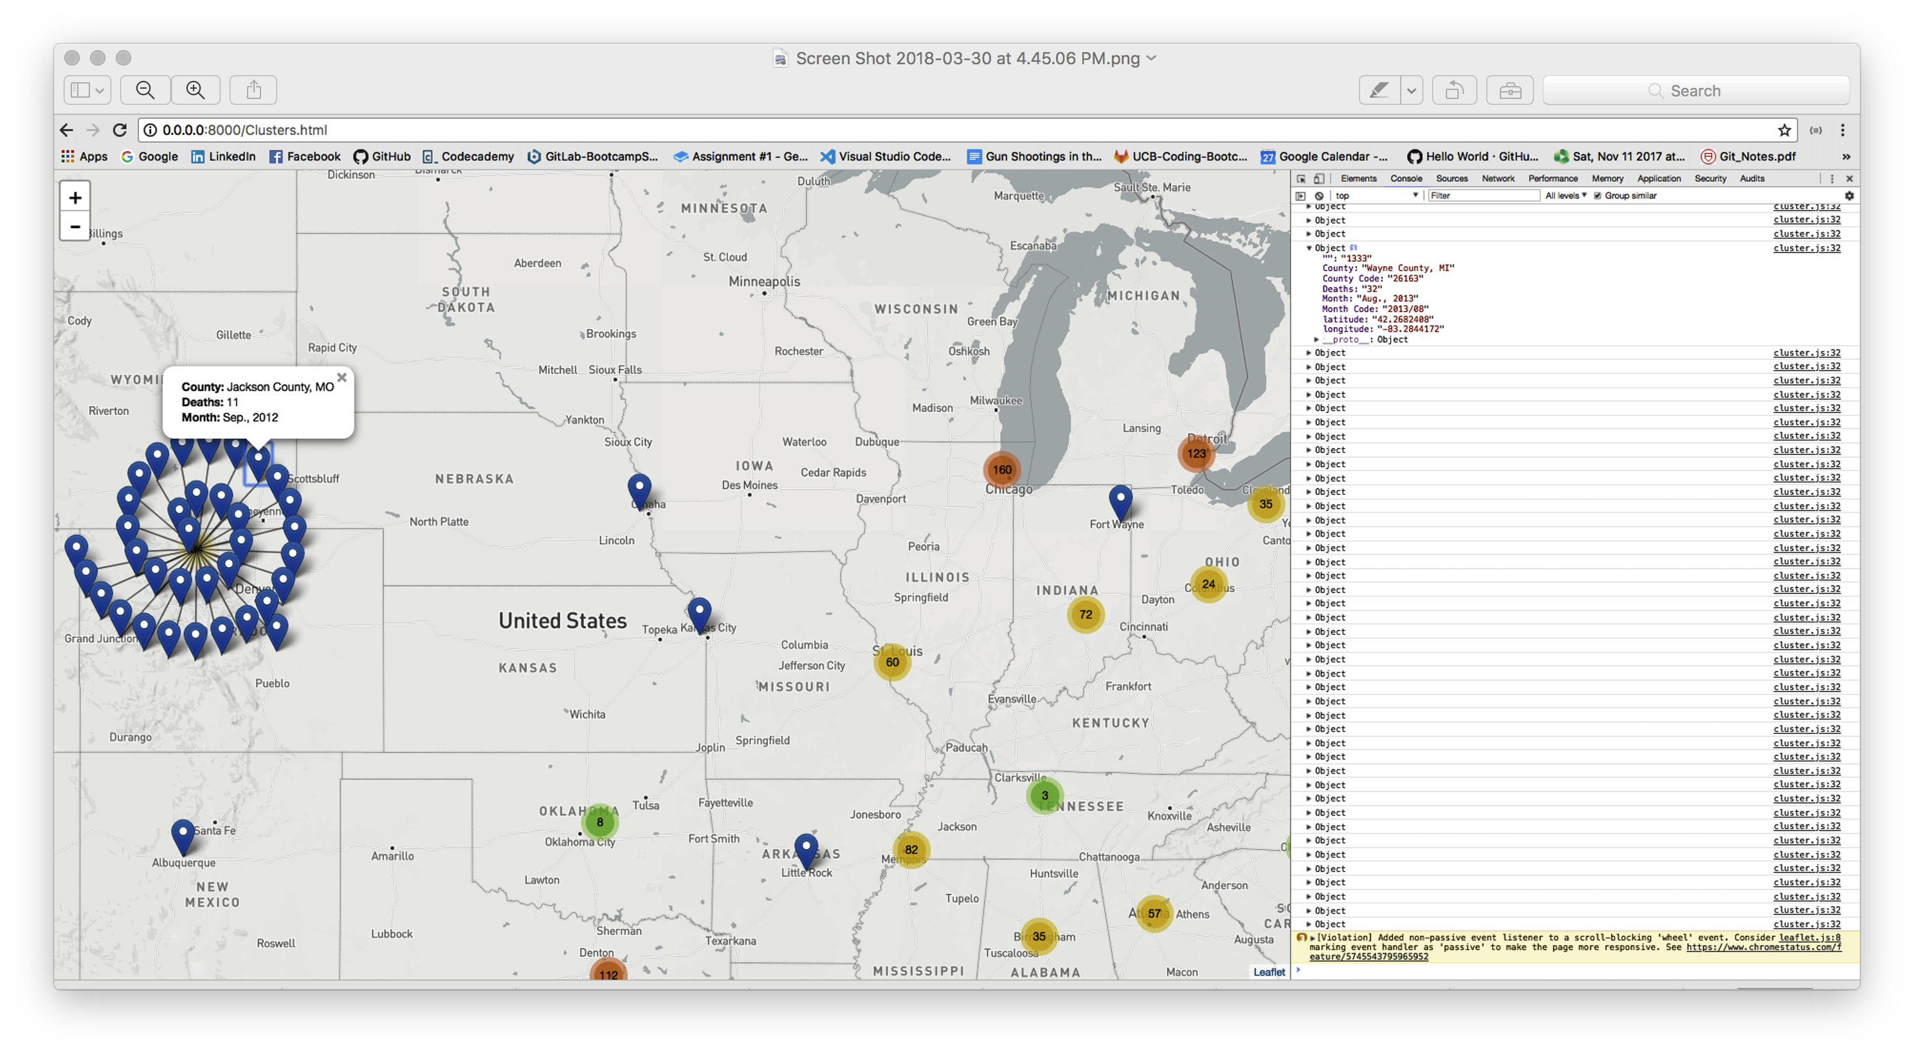
Challenge: Mass shooting by same county had this ripple snail effect -
As every same county has the same geolocation, with different dates/timeframe.

Slide 15
Questions / Discussion
Notes:
It’s important to keep in mind why you joined this class. Let’s talk about your goals.

